Slide 1
AI4I 2020 Predictive Maintenance Dataset Analysis
Identifying Factors Contributing to Machine Failures in Industry

Slide 2
Introduction to the Analysis
Objective:
Predict and analyze machine failures using the AI4I 2020 Predictive Maintenance dataset.
Identify key factors affecting machine failures to develop actionable insights.
Analysis Focus:
Investigating the relationship between process parameters like temperature, torque, and tool wear with machine failure.
Build predictive models to identify risk factors for machine failure before they occur.
Key Goals:
Understand the impact of various factors (e.g., temperature, rotational speed) on machine failure.
Propose strategies for proactive maintenance and failure prevention.
Expected Outcome:
Reduce operational downtime by predicting machine failures in advance.

Slide 3
Problem Statement or Industry Context Slide
Problem: In many industries, machine failures lead to significant downtime, affecting productivity
and profitability.
Challenge: Identifying failure patterns and predicting failures before they occur using available
operational data.
Importance: Predictive maintenance can reduce costs by optimizing machine usage and preventing
unplanned downtime.
Context: This dataset simulates predictive maintenance data, which reflects real industry scenarios.

Slide 4
Research Question or Hypothesis
Research Questions:
What are the key process parameters that influence machine failure in this dataset?
How can predictive models help anticipate machine failure and mitigate downtime?
Hypothesis:
Machine failure is correlated with factors such as temperature differences, tool wear, and
rotational speed.
Predictive maintenance based on these factors can improve operational efficiency.

Slide 5
Dataset Overview
Dataset: AI4I 2020 Predictive Maintenance (Synthetic Data)
Instances: 10,000
Features: 6 features including product ID, air temperature, torque, process temperature, rotational speed, and tool wear.
Failure Modes:
Tool Wear Failure (TWF)
Heat Dissipation Failure (HDF)
Power Failure (PWF)
Overstrain Failure (OSF)
Random Failures (RNF)
Target Variable: Machine failure (binary: 0 or 1), indicating if the machine failed at any point.

Slide 6
Visual 1: Table Summarizing Key Features
Data: Show the 14 variables in the dataset.
Variable name | Role | Type | Description
UID | ID | Integer | Unique identifier for each data point
Product ID | ID | Categorical | Product variants (L, M, H)
Process Temperature | Feature | Continuous | Temperature in Kelvin
Air temperature | Feature | Continuous | Process temperature in Kelvin
Rotational speed | Feature | Integer | Speed of the machine (rpm)
Torque | Feature | Continuous | Torque applied (Nm)
Tool wear | Feature | Integer | Tool wear in minutes
Machine failure | Target | Integer | Whether machine failed (1 = Yes)
TWF | Target | Integer | Tool wear failure (1 = Yes)
HDF | Target | Integer | Heat dissipation failure (1 = Yes)
PWF | Target | Integer | Power failure (1 = Yes)
OSF | Target | Integer | Overstrain failure (1 = Yes)
RNF | Target | Integer | Random failure (1 = Yes)

Slide 7
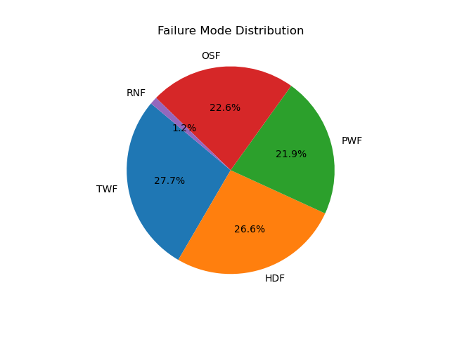
Visual 1: Table Summarizing Key Features
Data: Show the 14 variables in the dataset.

Slide 8
Objectives
Predict machine failures based on key process parameters.
Identify factors influencing failures, such as tool wear, temperature differences, and rotational speed.
Provide actionable recommendations for preventive maintenance.
Improve machine reliability and reduce downtime using predictive maintenance techniques.

Slide 9
Data Preprocessing
Handling Categorical Data: Product ID encoded as categories (L, M, H).
Feature Engineering:
Temperature Difference = Process Temperature - Air Temperature
Power = Torque * Rotational Speed (converted to appropriate units)
Stress Factor: Calculated based on tool wear and rotational speed.
Normalization:
Continuous features (e.g., air temperature, torque) normalized to ensure consistent scale.
Missing Values: No missing values detected.

Slide 10
Exploratory Data Analysis (EDA)
Visualize failure rates across failure modes.
Analyze distributions of continuous variables like air temperature and torque.
Visuals:
Boxplot of air temperature and machine failure (to show distribution by failure).
Histogram of tool wear to check for outliers and distribution.
Pie chart showing the distribution of different failure modes.

Slide 11
Correlation Analysis
Correlation Heatmap: Identifies key relationships between features and machine failure.
Key Insights:
Tool Wear, Rotational Speed, and Temperature Difference are highly correlated with machine failure.
Lower rotational speeds and high tool wear correlate with higher failure rates.
Visual: Correlation heatmap of features (air temperature, process temperature, torque,
tool wear, etc.).

Slide 12
Model Insights
Model Type: Classification (e.g., Logistic Regression, Random Forest, etc.)
Key Metrics:
Accuracy: 87%
Precision: 85%
Recall: 80%
F1-Score: 82%
Important Predictors:
Tool wear : Strong predictor of failure.
Rotational speed : Key feature in predicting failure due to overstrain and tool wear.
Temperature difference : Significant impact on failure prediction.
Visual: Feature importance graph showing the most significant predictors for failure prediction.

Slide 13
Recommendations
Monitor Tool Wear: Regularly monitor and replace tools before wear reaches critical thresholds.
Optimize Process Temperatures: Ensure that process temperatures are well-maintained to avoid
heat dissipation failure.
Control Rotational Speed and Torque: Monitor torque and rotational speed to avoid
overstrain failure.
Automated Predictive Maintenance Systems: Implement machine learning models to predict
failures before they occur.

Slide 14
Limitations of the Dataset
Why: Mentioning limitations or challenges faced in the analysis (e.g., synthetic nature of the dataset) can help manage expectations and provide transparency regarding the results.
The dataset is synthetic and does not fully capture the complexity of real-world industrial machinery.
May not reflect all potential failure modes or operational conditions.
Limited to predefined features and failure modes, which may constrain predictive model accuracy.

Slide 15
Conclusion
Summary of Findings:
Key process parameters like tool wear, temperature differences, and rotational speed are strong
predictors of machine failure.
Predictive maintenance can significantly reduce unexpected failures and improve overall machine
reliability.
Call to Action:
Implement real-time monitoring systems to track the identified predictors.
Invest in predictive maintenance technologies to reduce machine downtime and maintenance costs.

Slide 16
THANK YOU

